Slide 1
Operating System
Final Project
Team Members: Ranjan Khadka, Elijah Carter and Aakash Basnet

Slide 2
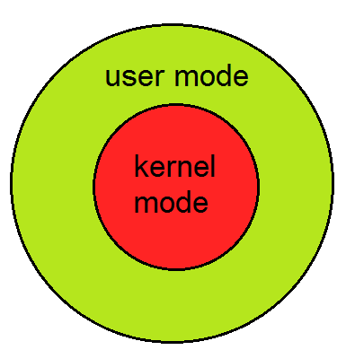
GOAL
Implement a file attributes system on the kernel level
for a custom linux system
Using syscalls, weave the file attributes system seamlessly
with other capabilities

Slide 3
System Calls
set attributes
get attribute list
get attribute
remove attribute

Slide 4
Set Attribute
We were passed character pointers to filename, attribute name, attribute value and an integer.
The first step is to create the “.file_attr” directory name from the file name given
Then a file stat block is used to identify and create the directory and attribute file
If the attribute directory does not exist, it is created. Same with the attribute file. If the file exists, it is replaced with a new one

Slide 5
Get Attribute
This system call get the value associated with a certain attribute name inside the attribute directory of any given file.
In order to do that, we created the path through the attribute directory opened the attribute file and read its value.
A copy of the attribute value is returned to the user

Slide 6
Get Attribute List
This system call gives us the name of all the attributes within the attribute directory of any given file.
In this system file too, we created the path through the attribute directory.
We then used the while loop to read all the names of the attribute files. We then stored the name of the attribute files in the buffer.

Slide 7
Remove Attribute
This system call deletes the name of the attribute passed as one of the parameters.
Int this system call, like before we created our path through the attribute directory of any given filename and then removed the attribute matching the given attribute name.
If the attribute removed is the last one in the attribute directory, the directory is removed as well.

Slide 8
User Space Test Programs
We used two user space programs to test our system calls: setattr and listattr
The former sets the attribute for any given list of files with a name , value pair.
The listattr program takes a attribute name and file(s) and lists the attributes values for those attributes and for those files.

Slide 9
Kernel Modifications & Benchmarking
Our team attempted to modify the unlink and rename syscalls in the kernel
However, we were not able to accomplish this task.
Likewise, with benchmarking programs.

Slide 10
Conclusions
Creating new system calls is both simple and complex
We wonder if operating in the kernel space is by necessity more fraught with errors and dangers in order to protect the operating system.
We poured through unwieldy documentation for hours in order to perform operations that are simple in the user level.
All in all, the project was satisfying but stressful.

